Slide 1
Bloch Sphere and Density Operator
Visualization of quantum states
不正经讲师：理科宅Hunt

Slide 2

Bloch Sphere
The coefficients of a normalized quantum states must satisfy
$$\left|ψ\right\rangle =a\left|0\right\rangle +b\left|1\right\rangle , with {\left|a\right|}^{2}+{\left|b\right|}^{2}=1$$
A normalized quantum state must be on a “sphere” (Bloch sphere).
This sphere is called Bloch sphere
Using polar angle, $θ$, and azimuthal angle, $φ$, we can write
$$\left|ψ\right\rangle =\left[\begin{aligned}\cos{\frac{θ}{2}} \\ e^{iφ}\sin{\frac{θ}{2}} \end{aligned}\right]$$

Slide 3
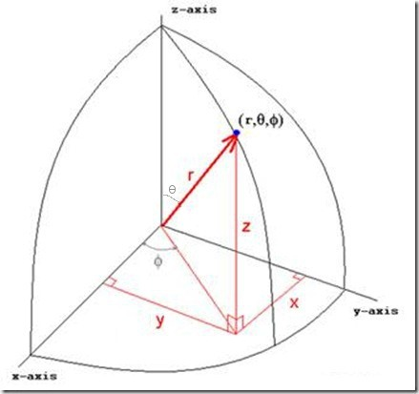
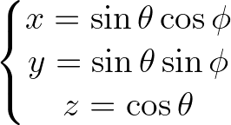
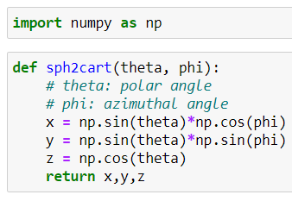


Example – Visualization in Qiskit
Unfortunately, Qiskit does not provide convenient visualization in $(θ,φ)$ representation, we need to convert this to $(x,y,z)$.
$$r=1$$

Slide 4
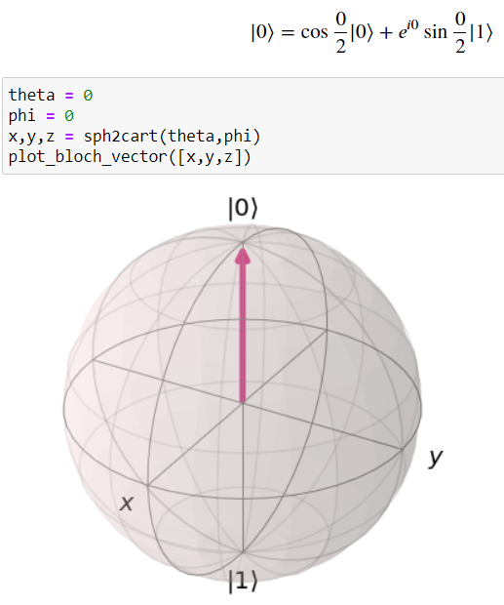
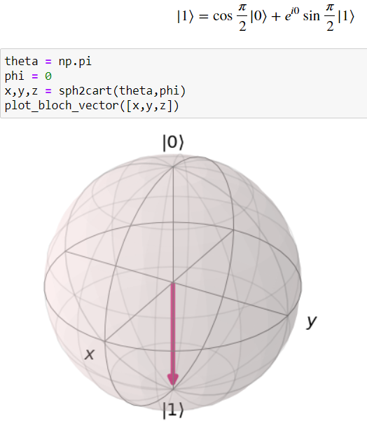
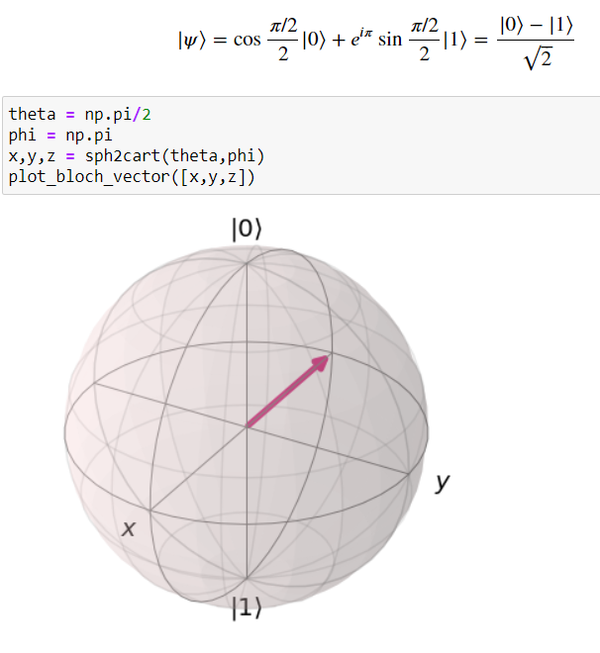

Slide 5

Global and relative phase
In computational basis, we can express a quantum state as
$$\left|ψ\right\rangle =e^{iγ}\left(\cos{\frac{θ}{2}}\left|0\right\rangle +e^{iφ}\sin{\frac{θ}{2}}|1⟩\right)$$
Where $e^{iγ}$ is called global phase, $e^{iφ}$ is called relative phase.
Global phase DOES NOT affect anything (we can ignore it).
Relative phase IS important, DO NOT forget it.

Slide 6
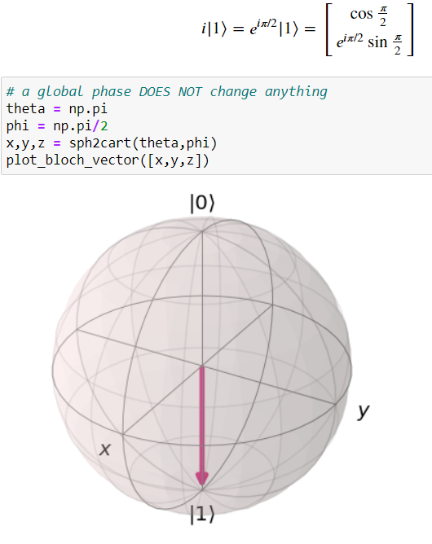
Example

Slide 7


Unitary operators
Definition: An operator, $U$, is unitary if $U^{†}U=UU^{†}=I$.
Unitary operator PRESERVES the norm.
$${\left\| U\left|ψ\right\rangle \right\|}^{2}=\left\langle ψ\left|U^{†}U\right|ψ\right\rangle =\left\langle ψ | ψ\right\rangle =‖{\left. \left|ψ\right\rangle ​\right\|}^{2}$$
In other words, unitary operators keep quantum states on the Bloch sphere.
Examples: Pauli matrices.

Slide 8



Rotation about arbitrary axis
$$\hat{n}$$
Pauli-Euler relation:
$$\exp\left(iα\hat{n}⋅\vec{σ}\right)=cos\left(α\right)I+i\sin\left(α\right)\hat{n}⋅\vec{σ}$$
$\hat{n}$ is a unit vector in $ℝ^{3}$.
$\vec{σ}=X\hat{x}+Y\hat{y}+Z\hat{z}$ is a vector of Pauli matrices.
For example: $\hat{x}⋅\vec{σ}=X=\left[\begin{matrix}0 & 1 \\ 1 & 0\end{matrix}\right]$
To rotate a state $|ψ⟩$ along unit vector $\hat{n}$ with angle $α$, multiply the rotation matrix $R_{\hat{n}}(α)$,
$$R_{\hat{n}}\left(α\right)\left|ψ\right\rangle =\exp\left(−i\frac{α}{2}\hat{n}⋅\vec{σ}\right)\left|ψ\right\rangle$$

Slide 9
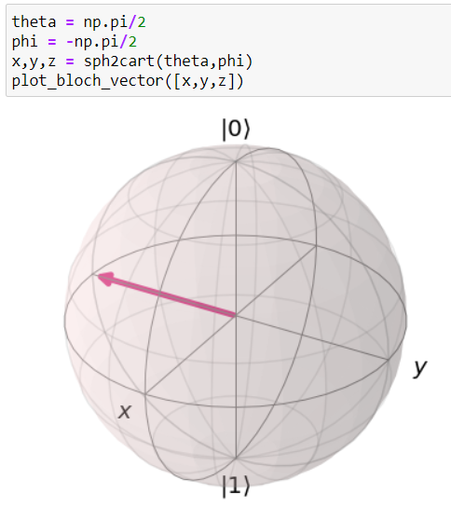
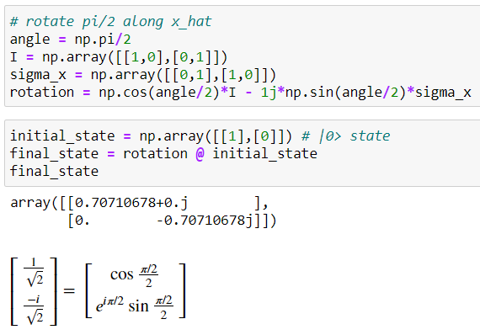


Example
Rotate $|0⟩$ along $\hat{x}$ by $\frac{π}{2}$.
Rotation matrix $R_{\hat{x}}\left(\frac{π}{2}\right)=\cos{\frac{π/2}{2}}I−i\sin{\frac{π/2}{2}}\left(\hat{x}⋅\vec{σ}\right)$

Slide 10

Pure state and mixed state
A pure state is a quantum state can be represented as a single vector.
That means, all vectors on the surface Bloch sphere are pure states! Since they can be written as
$$\left|ψ\right\rangle =\left[\begin{aligned}\cos{\frac{θ}{2}} \\ e^{iφ}\sin{\frac{θ}{2}}\end{aligned}\right]$$
A mixed state is a vector inside Bloch sphere.

Slide 11
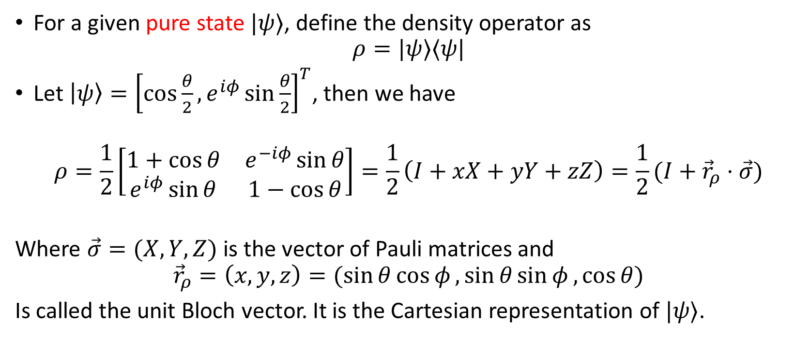
Density matrix and Bloch vector
For a given pure state $|ψ⟩$, define the density operator as
$$ρ=|ψ⟩⟨ψ|$$
Let $\left|ψ\right\rangle ={\left[\cos{\frac{θ}{2}}, e^{iφ}\sin{\frac{θ}{2}}\right]}^{T}$, then we have
$$ρ=\frac{1}{2}\left[\begin{matrix}1+\cos{θ} & e^{−iφ}\sin{θ} \\ e^{iφ}\sin{θ} & 1−\cos{θ}\end{matrix}\right]=\frac{1}{2}\left(I+xX+yY+zZ\right)=\frac{1}{2}(I+{\vec{r}}_{ρ}⋅\vec{σ})$$
Where $\vec{σ}=(X,Y,Z)$ is the vector of Pauli matrices and
$${\vec{r}}_{ρ}=\left(x,y,z\right)=(\sin{θ}\cos{φ},\sin{θ\sin{φ},\cos{θ}})$$
Is called the unit Bloch vector. It is the Cartesian representation of $|ψ⟩$.

Slide 12

Purity
Define purity of a quantum state $|ψ⟩$ as
$$γ=Tr\left(ρ^{2}\right)$$
Where $ρ=|ψ⟩⟨ψ|$ is the density operator of $|ψ⟩$.
Purity measures how much a state is mixed.
$\frac{1}{d}≤γ≤1$ where d is the dimension of the Hilbert space.
$γ=1$ if it’s a pure state, $γ=1/d$ if it’s a completely mixed state.
Suppose ${\vec{r}}_{1}$ and ${\vec{r}}_{2}$ are the Bloch vectors of two pure states $|ψ_{1}⟩$ and $|ψ_{2}⟩$, then
$${\left|\left\langle ψ_{1} | ψ_{2}\right\rangle \right|}^{2}=Tr\left(ρ_{1}ρ_{2}\right)=\frac{1}{2}(1+{\vec{r}}_{1}{⋅\vec{r}}_{2})$$
This formula relates the inner product in $H$ and the inner product in $ℝ^{3}$.

Slide 13
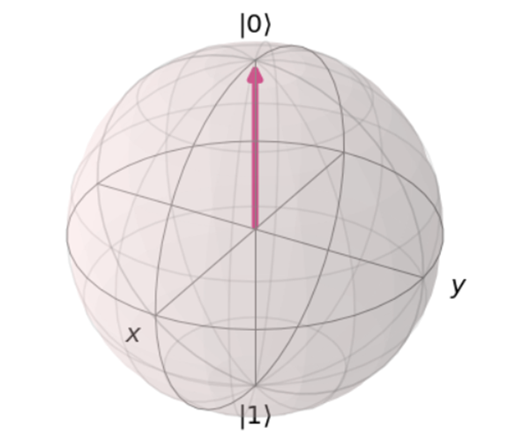
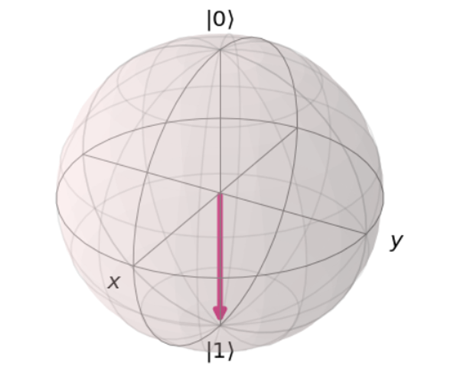

Example – Bloch sphere geometry
Suppose $\left\langle ψ_{1} | ψ_{2}\right\rangle =0$ (orthogonal in $H$), how do they look like on Bloch sphere?
Using the formula,
$${\left|\left\langle ψ_{1} | ψ_{2}\right\rangle \right|}^{2}=\frac{1}{2}(1+{\vec{r}}_{1}{⋅\vec{r}}_{2})$$
Since $\left\langle ψ_{1} | ψ_{2}\right\rangle =0$, so we have${\vec{r}}_{1}{⋅\vec{r}}_{2}=−1$. $\left|ψ_{1}\right\rangle$ and $|ψ_{2}⟩$ have opposite directions!

Slide 14
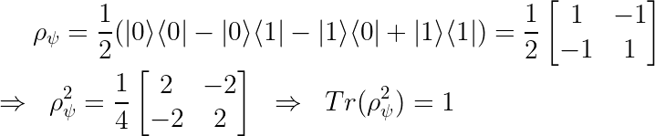

Example – Purity
Let $\left|ψ\right\rangle =\frac{\left|0\right\rangle −|1⟩}{\sqrt{2}}$, calculate its purity.
This is obvious, since $|ψ⟩$ can be drawn on Bloch sphere, so it is a pure state.

Slide 15
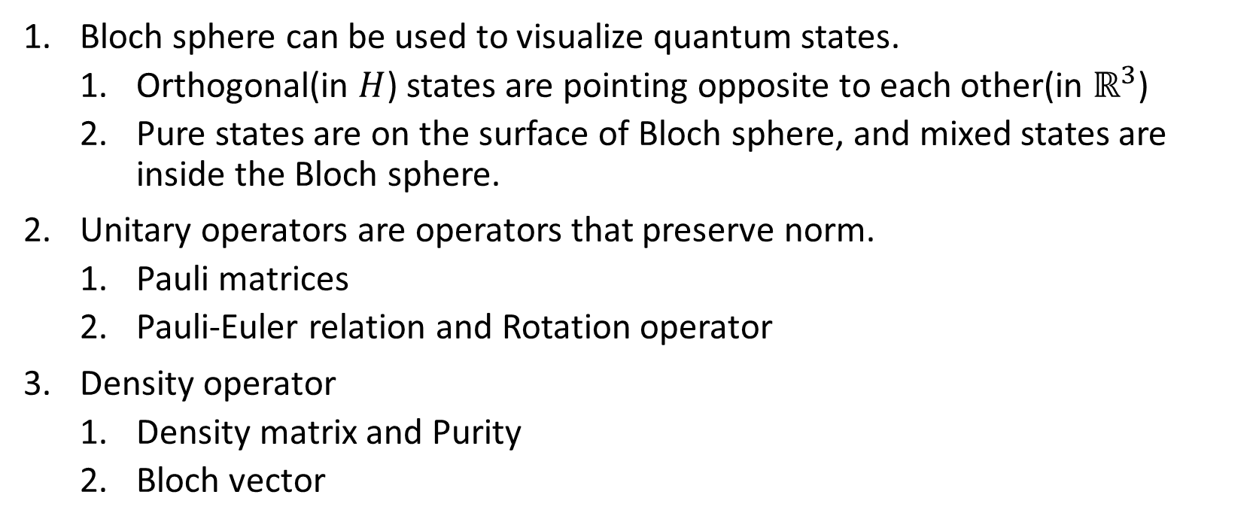
Summary
Bloch sphere can be used to visualize quantum states.
Orthogonal(in $H$) states are pointing opposite to each other(in $ℝ^{3}$)
Pure states are on the surface of Bloch sphere, and mixed states are inside the Bloch sphere.
Unitary operators are operators that preserve norm.
Pauli matrices
Pauli-Euler relation and Rotation operator
Density operator
Density matrix and Purity
Bloch vector

